Slide 1

Performance Workshop Intro
🔥

Slide 2




Michael Hladky
CEO | Trainer, Consultant michael.hladky@push-based.io
@Michael_Hladky

Slide 3


Julian Jandl
Performance Engineer Trainer & Consultant
@rx-angular core maintainer
@hoebbelsB

Slide 4
Block 1
09:00 - 10:30
☕ Coffee Break (20 min)
Organization
Block 2
10:50 - 12:00
Lunch Break (2 hr)
Block 3
14:00 - 15:10
☕ Coffee Break (20 min)
Block 4
15:30 - 17:00
Q&A + Hands-On
“Open end”

Slide 5
Don’t hesitate to ask questions all the time!
🤓

Slide 6
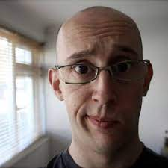
Performance is
the art of avoiding work
Paul Lewis

Slide 7
Why do we care about
performance anyway?
🤔

Slide 8

Human perception
👏 Users want apps to be snappy
🎞 60 fps Device Refresh Rates
- 60 times per second new frame on screen
- 16.66ms Budget ( 1 second / 60 frames )
Notes:
In fact only 10ms because of browsers housekeeping work

Slide 9
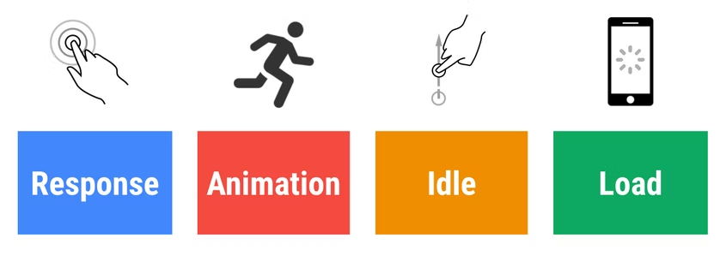
RAIL Model
🔗 RAIL model

Slide 10
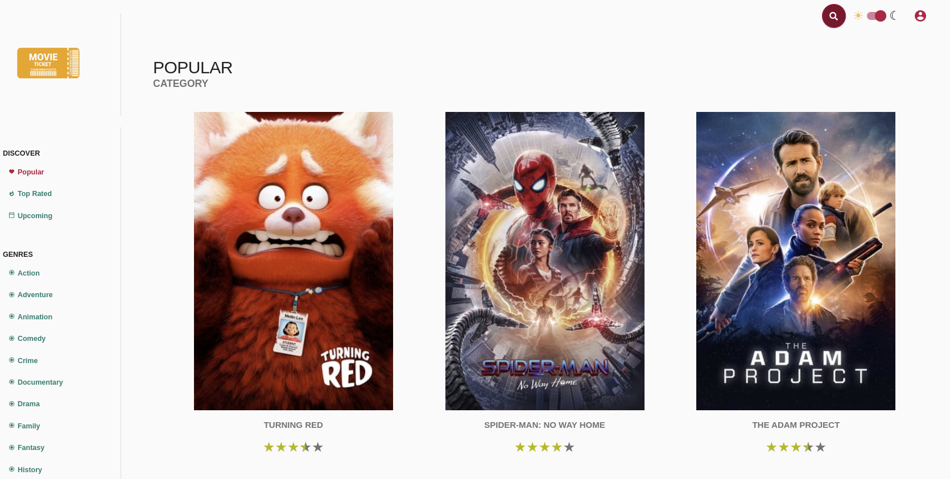
What are we going to do?
Analyze & Improve Performance on a real-world example
Angular Movies github link
tastejs movies app perf contest

Slide 11
Performance
Change Detection In-Depth
zone.js & NgZone -> zoneless future
Reactivity Model w/ Signals 🚦
Browser Render Pipeline
Core Web Vitals
Performance Analysis & Flame Charts
JS Event Loop
Network analysis & improvements
User Flows
... and more

